Slide 1
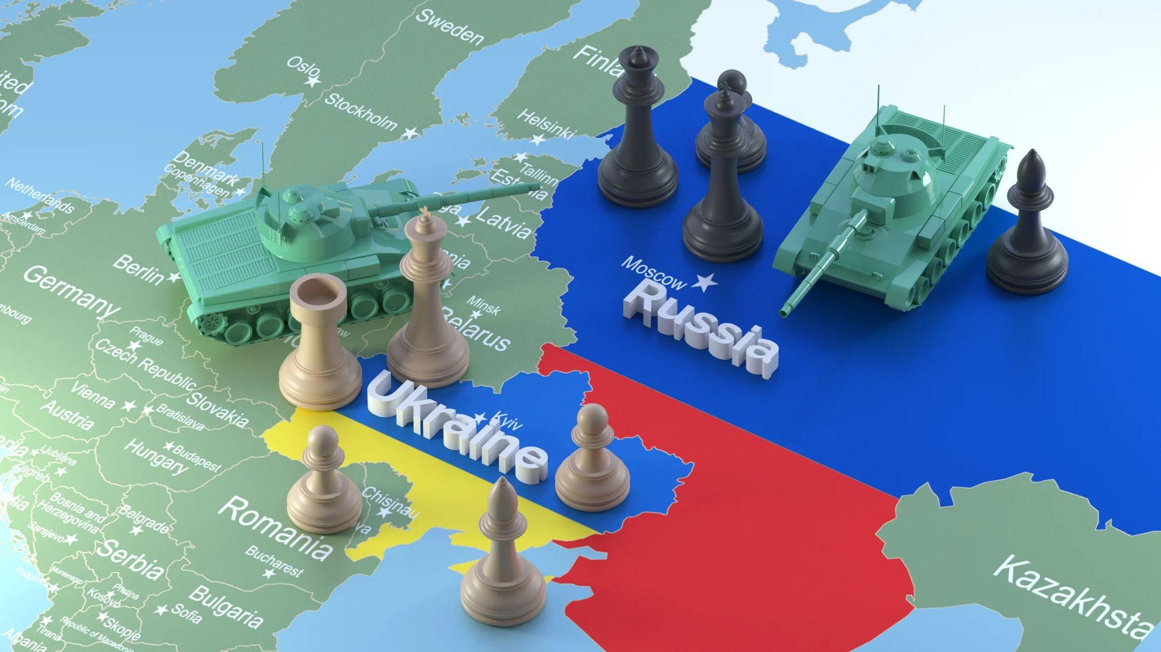

Slide 2

Russia & Ukraine Crisis Analysis Through Tweets
EDA Course Project: 4EDACP06
Team: E17
Team Members:
Prakash Kumar Singh (539)
Mohit Gumber (541)
Srishti Saurav (529)

Slide 3
Problem Statement
“Analysis of the current status of Ukraine affected by Russo-Ukraine War (from Twitter data)”

Slide 4
Data Gathering

Slide 5
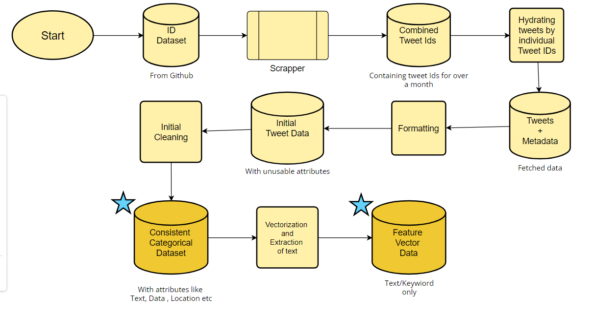
Data Gathering Flow

Slide 6
Data Understanding

Slide 7
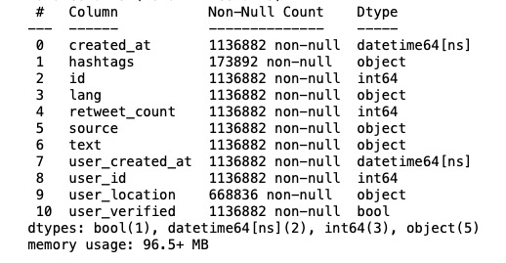
Obtained Dataset
Our dataset obtained via Twitter API consists of data related to tweets stored in a .csv format with the attributes:

Slide 8
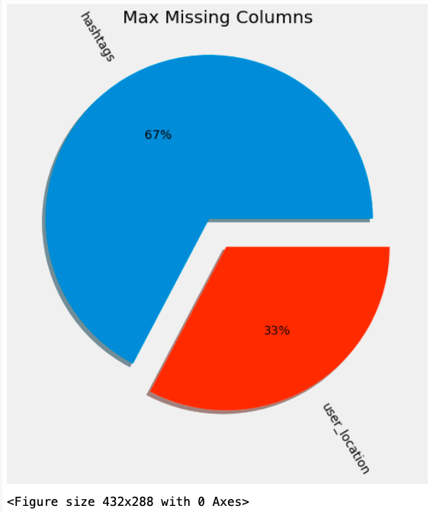
Majority of the People didn’t use any hashtags
Or share their location
While tweeting about the crisis still being vocal about their thoughts on the matter making twitter a source of vast range of emotion and information

Slide 9
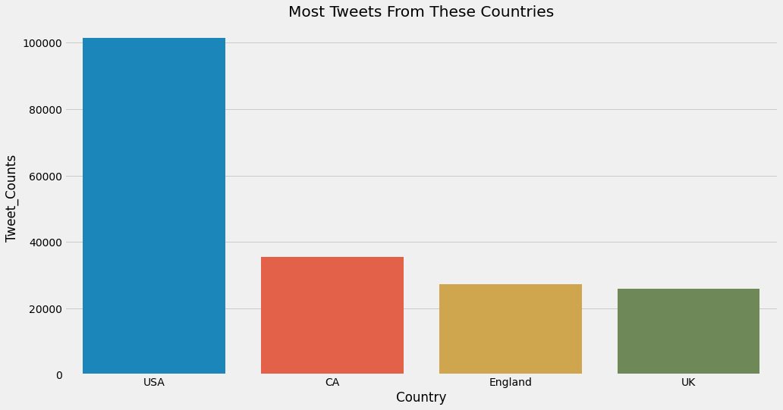
As evident from the plot, there is a large proportion of the Americans being vocal about the speculation about the crisis, involvement in which is deterministic for diplomatic relations between the US and Russia

Slide 10
Data Preprocessing

Slide 11
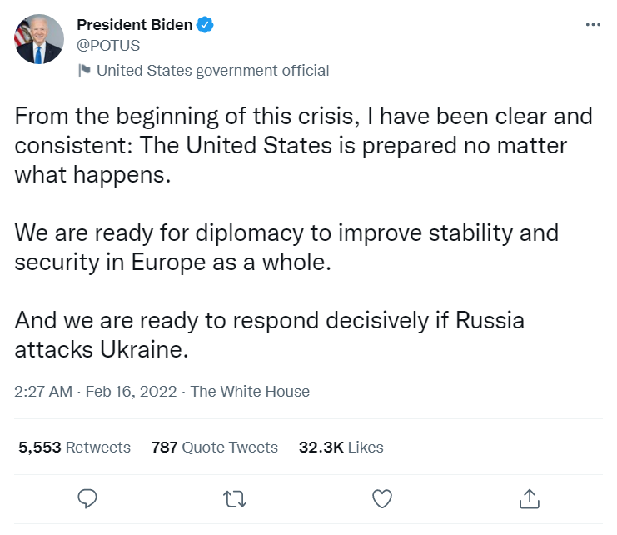
text
Created_at

Slide 12
Tweet Text Preprocessing
We perform the necessary text preprocessing steps on the Tweet text:
Removal of links to websites, such as news sites, youtube, etc.
Removal of punctuation and special characters.
Removal of stop words
Performing of stemming.
Performing lemmatization.
Creation of n-grams of chosen topics in the form of keywords.
Creation of corpus that is to be analyzed.

Slide 13
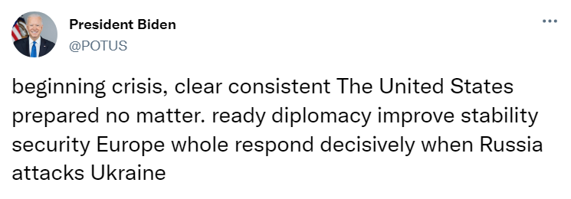

Slide 14
Data Visualization

Slide 15
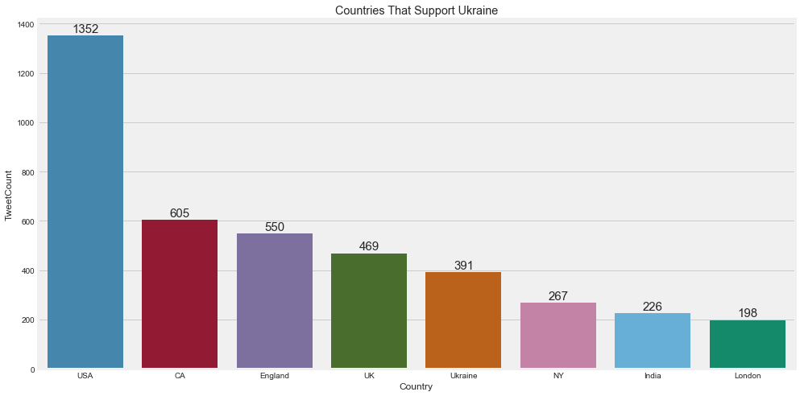
As evident from the plot, there is a large proportion of the Americans being vocal about the speculation about the crisis, involvement in which is deterministic for diplomatic relations between the US and Russia

Slide 16
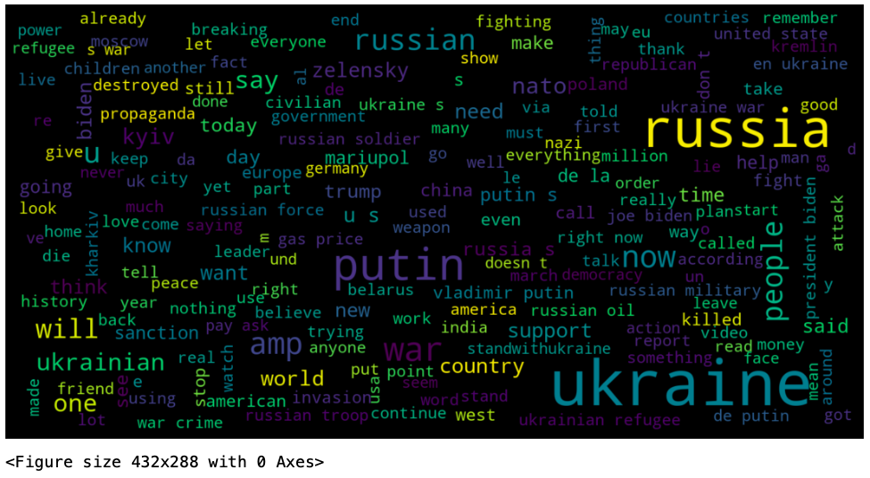
Word cloud showing the prominent words in the tweets.

Slide 17
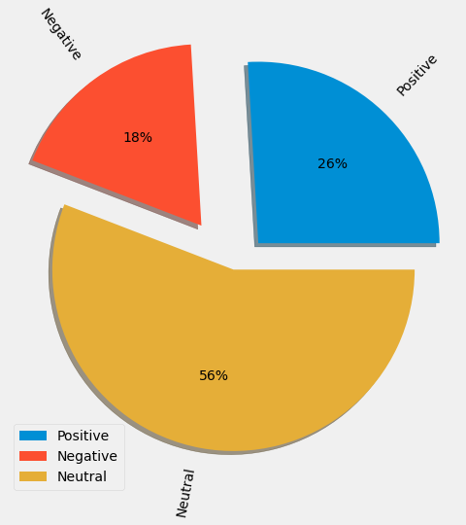
Besides the neutral sentiment, that includes discussions of the crisis, its impact on the globe, etc., there is a large positive sentiment of tweets in our data.

Slide 18
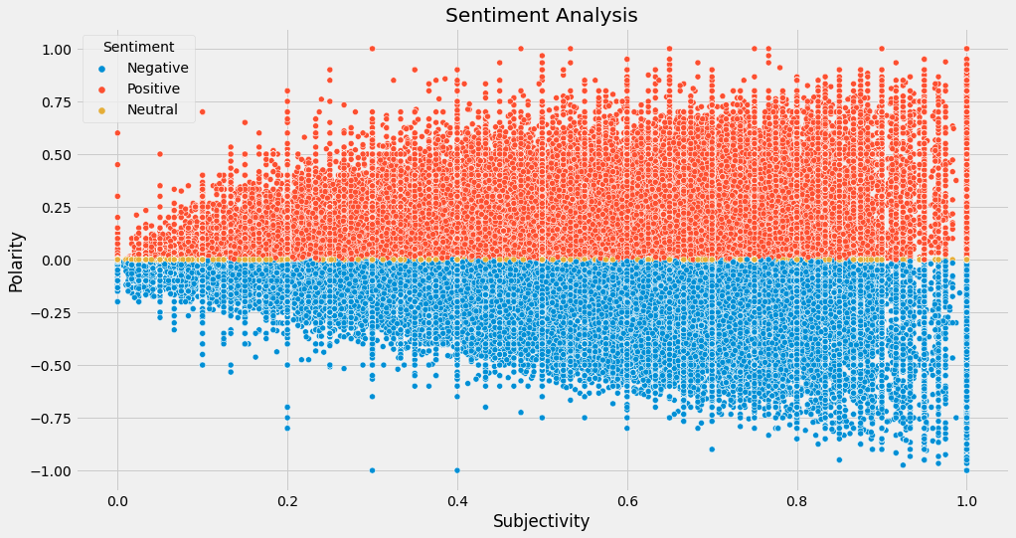

Slide 19
Approach To Analysis & Model Building I

Slide 20
Approach To Analysis & Model Building I
Determine how prevalent the topic of Ukraine’s socio-economic conditions is in the tweets made in context of the Russo-Ukrainian crisis.

Slide 21
Relevancy & Overlap Of Topics
For making appropriate predictions, we are using the LDA (Latent Dirichlet Allocation) algorithm which is an unsupervised machine-learning model that takes documents as input and finds topics as output. The model also says in what percentage each document talks about each topic.
A topic is represented as a weighted list of words:
Ukraine * 0.9 | Russia * 0.65 | peace * 0.19 |…

Slide 22
Significance Of LDA Algorithm
From our considered tweet text, it was difficult to derive a problem/topic to focus on, so we used LDA to see the relevancy of topics, as in understand what topics are more talked about.
By performing LDA, we derived that “economy” was a highly significant topic, so we decide to focus on the same. From our domain understanding we know that we need to try to forecast the situation of the Ukrainian economy. This can be derived from the user sentiment with regards to it, which may or may not align with actual events.

Slide 23
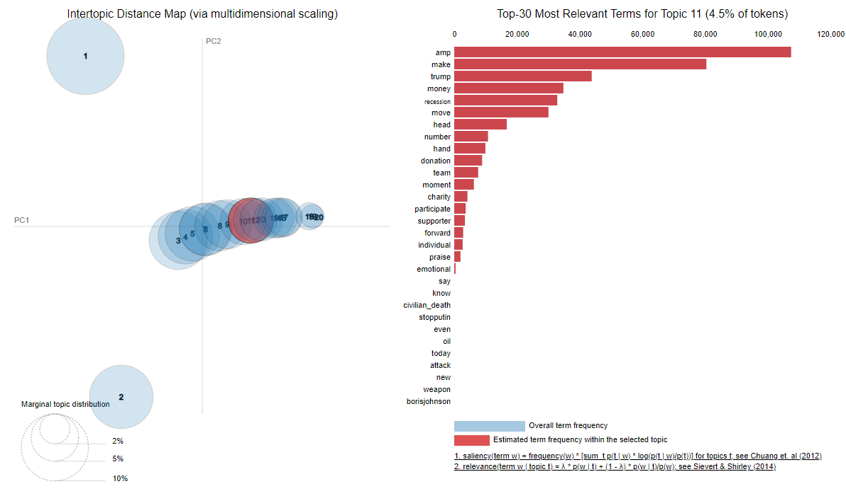
LDA Plot

Slide 24
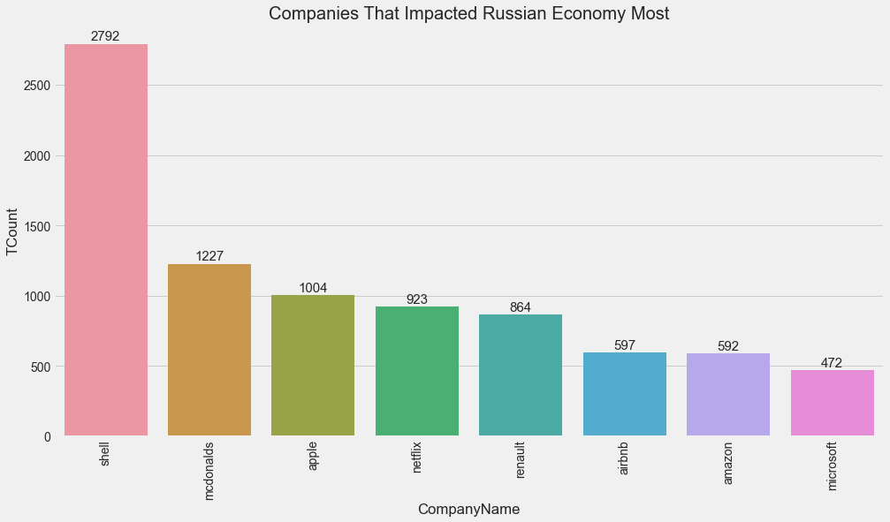
Companies with a significant impact on the Russian economy

Slide 25
Question, Analysis & Inference

Slide 26
Question 1
“What is the general sentiment regarding the situation and further developments that can take place in the Ukrainian economy gravely affected by the war?”
Here, we are looking into the analysis of a multitude of factors that directly or indirectly impact the Ukrainian as well as global economy.

Slide 27
Approach To Analysis & Model Building II

Slide 28
Approach To Analysis II
Predicting the future public sentiment regarding developments in the Ukrainian economy

Slide 29
Predicting / Forecasting Future Sentiment
Here, we are making use of the Prophet Model which is an open source library published by Meta that is based on decomposable (trend+seasonality+holidays) models.
It provides us with the ability to make time series predictions with good accuracy using simple intuitive parameters and has support for including impact of custom seasonality and holidays.

Slide 30
Significance Of Prophet Algorithm
We decided to use Prophet algorithm as it converts the data into stationary form and it has clearer visualization compared to other similar models/methods.

Slide 31
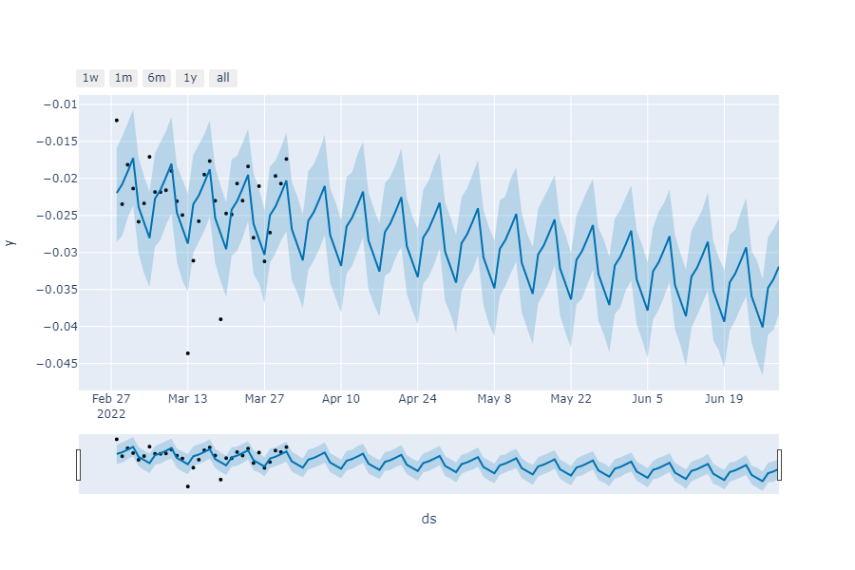
Prediction plot showing the growing negative concern regarding economy.

Slide 32
Inference
From the previous plot, we can infer that there will be a growing negative sentiment regarding the Ukrainian economy, which may imply that the Ukrainian economy is on a way to shrinking, making it very difficult for the country to be brought back up to the pre-war Ukrainian standard of living.

Slide 33
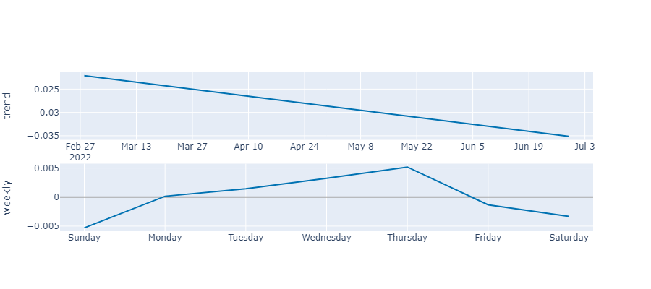
Weekly & Daily Trend

Slide 34
Inference
From the previous plot, we can infer that on a weekly & daily basis, the concern for the Ukrainian economy fluctuates, but peaks every week. This is potentially due to news reports that are generated in context of the crisis on a daily & weekly basis.

Slide 35
Question 2
“Predicting what is the general stance regarding Ukraine in the Russo-Ukrainian crisis?”
Here we are trying to segregate the data into two groups mainly, “In Support” and “Not in Support”

Slide 36
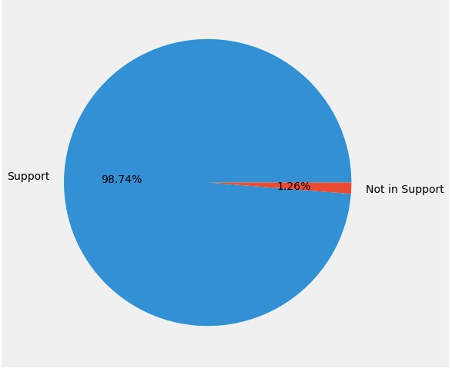
Segregated Data
Naive Bayes Algorithms
Gaussian Naive Bayes
Accuracy: 35%
Precision Score: 15%
Multinomial Naive Bayes
Accuracy: 91%
Precision Score: 81%
Bernoulli Naive Bayes
Accuracy: 99%
Precision Score: 95%

Slide 37
Conclusions
From our analysis, we have concluded that there is a growing concern regarding the state of Ukraine, under the Russo-Ukrainian crisis and a general support for Ukraine against Russian aggression that needs to end.

Slide 38
Thank you

